Slide 1
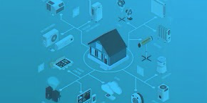
Securing IOT devices: A case study on home automation
Sv. Deepthi (AP23110010605)
P. Teja Sri (AP23110010625)
P. Hemanath (AP23110010616)
K. Dushyanth (AP23110010585)
Lohith Naidu (AP23110011152)

Slide 2
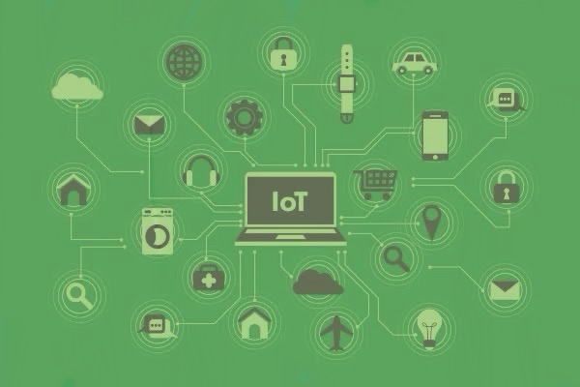
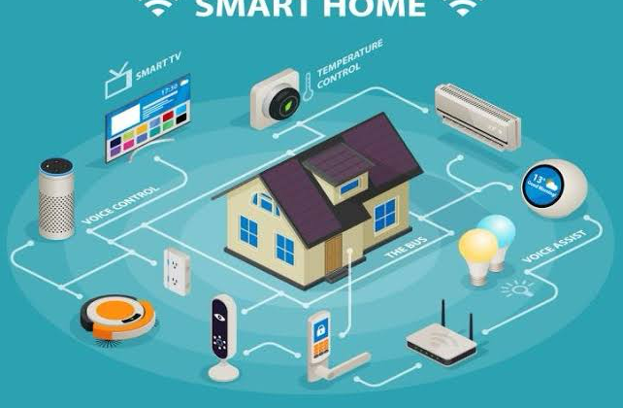
Agenda
What is IoT, Cyber Security, and Home Automation ??
How is IoT and CS used in Home Automation ??
What is Malware, Bugs, and Viruses ??
Examples of malware, and bugs..
What is Call Stranger (CVE – 2020 – 12695)
Understanding UPnP
The bug - CVE – 2020 – 12695
How call stranger works and Real world implications
Vulnerability overview and Attack Mechanisms
Main Risks and Technical Details
Impact, Mitigation, and Protocol update
Call stranger in Future
Conclusion
Reference….

Slide 3
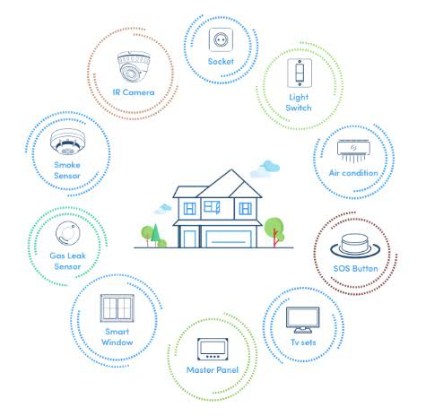
What is IoT, Cybersecurity, and Home Automation??
IoT - The Internet of Things (IoT) is a network of physical devices—like appliances, vehicles, and sensors—embedded with software and connectivity that enables them to collect, exchange, and act on data with minimal human intervention.
Cyber security – It protecting computers, networks, and data from being accessed, damaged, or stolen by hackers or malicious software.
Home Automation - Home Automation in IoT means using internet-connected smart devices and a central hub to remotely monitor, control, and automate household functions such as lighting, heating, security, and entertainment through a smartphone or app

Slide 4
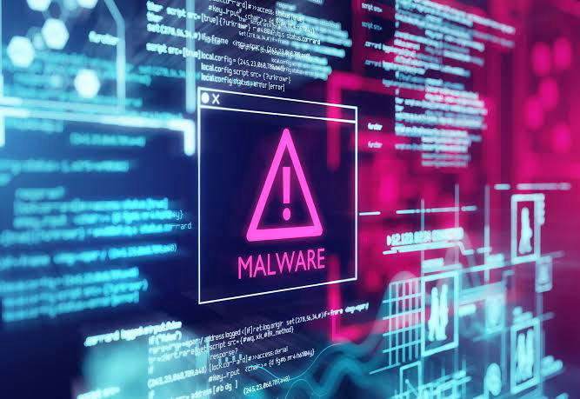
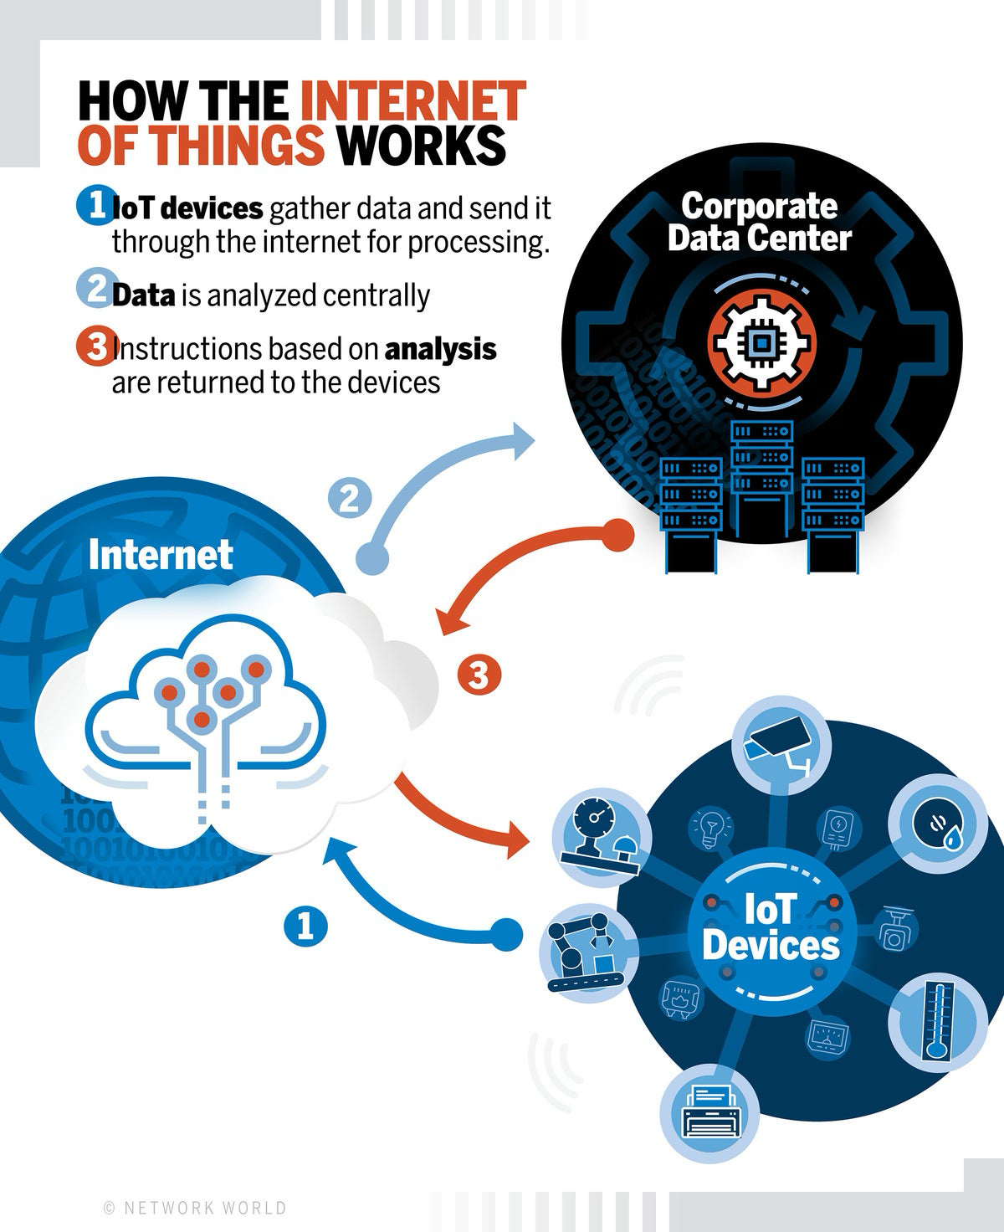
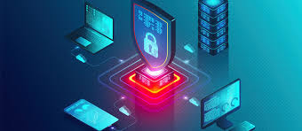
What is Malware, bug, and virus
Malware – short for malicious software, refers to any software designed to harm or exploit computer systems, networks, or devices.
Bugs – refer to flaws or vulnerabilities in the software or hardware that can be exploited by attackers to compromise the device, its network, or the data it handles.
Virus - typically refers to malware designed to infect and potentially harm these devices.

Slide 5
Examples of malware, and Bugs…
Malware Rookits
Malware identified by Nozomi Nozomi network botnet malware
Bug Call stranger (CVE -2020-12695)
Botnet malware Hajime (2016– active) Torii (2018- ongoing) Mirai (botnets)
Destructive malware Silex (2019)

Slide 6
What is call stranger (Cve – 2020 – 12965)
CVE-2020-12695, also known as the CallStranger vulnerability, affects the Universal Plug and Play (UPnP) protocol, potentially exposing billions of devices to data exfiltration and denial-of-service attacks. UPnP is widely used for automatic network device discovery and configuration, making its vulnerabilities a significant concern.

Slide 7
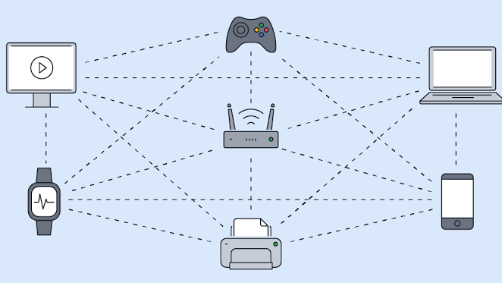
Understand UPnP
UPnP (Universal Plug and Play) is a set of networking protocols that allows devices on a network to automatically discover and communicate with each other, simplifying the process of connecting devices and sharing resources.
It enables devices like computers, printers, gaming consoles, and smart home devices to find each other, exchange information, and even control each other without manual configuration

Slide 8
The bug – cve – 2020 12695
In the Callback header of UPnP SUBSCRIBE requests
Improper input validation
Can send malicious URLs to devices
Attack Types:
SSRF attacks
Amplified DDoS attacks
Data exfiltration over NAT

Slide 9
How call stranger works and Real world implications…
Call Stranger works
Attack Flow:
Attacker sends malicious SUBSCRIBE request
Device initiates callback to attacker's server
Enables SSRF or exfiltration
Can be scaled using botnets
Real-World Implications
Used for data exfiltration from corporate and home networks
Amplified DDoS via millions of UPnP devices
Bypasses security appliances via NAT traversal
Note:
Many consumer devices had UPnP enabled by default

Slide 10
Vulnerability Overview and Attack Mechanisms
CVE‑2020‑12695 (CallStranger)
Found by Yunus Çadırcı
UPnP SUBSCRIBE improperly validates CALLBACK header
Allows Server-Side Request Forgery (SSRF)
Data Exfiltration via CALLBACK
DDoS Amplification
Internal Network Port Scanning

Slide 11
Main Risks and Technical Details
Main Risks
Technical Details
Data Exfiltration: Attackers can bypass conventional Data Loss Prevention (DLP) systems to exfiltrate sensitive data from internal networks.
Amplified TCP DDoS Attacks: The vulnerability enables attackers to leverage millions of UPnP-enabled devices as reflectors, facilitating large-scale distributed denial-of-service (DDoS) attacks.
Internal Network Scanning: Remote attackers can use affected devices to scan internal networks, gaining information about protected resources
Vulnerability Location: Universal Plug and Play (UPnP) protocol, specifically the SUBSCRIBE function.
Cause: The Callback header value in the UPnP SUBSCRIBE function can be controlled by an attacker. This permits unauthenticated remote execution of a Server Side Request Forgery (SSRF)-like attack.
Scope: All versions of the UPnP protocol released before April 17, 2020, are affected. This impacts billions of devices, including routers, PCs, printers, IoT gadgets, smart TVs, and gaming consoles.
Attack Vector: An attacker sends a specially crafted HTTP SUBSCRIBE request to a vulnerable UPnP device, specifying arbitrary delivery URLs in the Callback header.
Severity: CVSS 3.1 Base Score: 7.5 (High) — Network vector, high attack complexity, no privileges required, no user interaction required.

Slide 12
Impact, Mitigation, and Protocol update
Impact
Mitigation
Protocol Update
Data Loss or Theft: Sensitive or confidential data may be exfiltrated undetected, even through security perimeters.
Service Disruption: Targets (including external entities) may be overwhelmed by large volumes of unwanted traffic, leading to DoS.
Exposure of Internal Infrastructure: Attackers can scan and enumerate internal resources, potentially exposing further vulnerabilities.
Update to Patched Versions: Implement the updated UPnP specification released by the Open Connectivity Foundation (OCF) on April 17, 2020. Vendors and users should apply firmware or software updates that fix this flaw.
Disable UPnP: Especially on internet-facing interfaces. If possible, restrict UPnP services to only trusted local networks.
Disable or Restrict SUBSCRIBE Capability: Device manufacturers are urged to disable the SUBSCRIBE capability by default or allow users to selectively enable it with proper network restrictions
Specification Fix: The OCF updated the official UPnP specification (published April 17, 2020) to require stricter validation of the Callback header and to prevent acceptance of subscription requests with delivery URLs outside the trusted network segment.
Adoption: The responsibility for patching falls ultimately on device vendors to adopt the new specification in their products, which may take time due to the scale and diversity of affected devices.

Slide 13
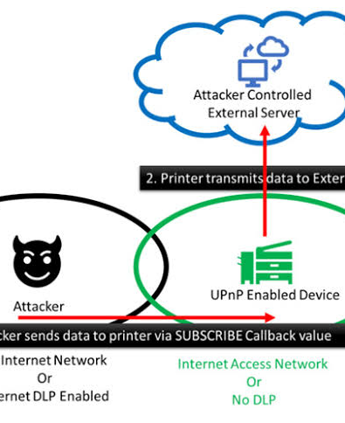
Call stranger in future
Millions of unpatched devices in use
IoT adoption in homes continues to grow
Attackers still scan for vulnerable devices
Need:
Better UPnP implementation standards
Vendor responsibility & consumer awareness.

Slide 14
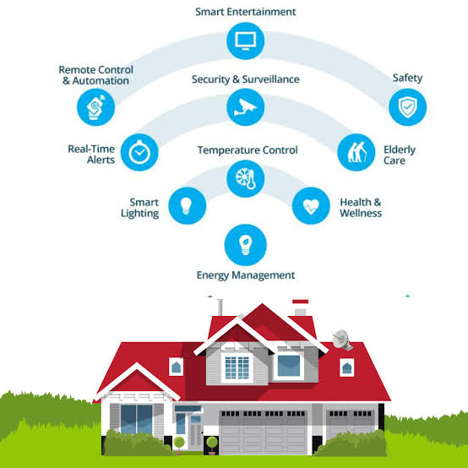
Conclusion
CallStranger exploits UPnP callback mechanisms
Poses serious risks to smart homes
Disabling UPnP and patching devices is critical
Awareness and network hygiene are essential

Slide 15
Reference…

Slide 16
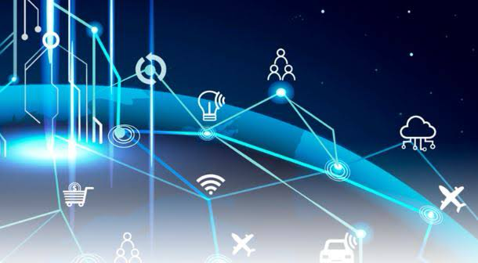
Thank you

